Slide 1





Finding Hierarchy in Facets

Slide 2
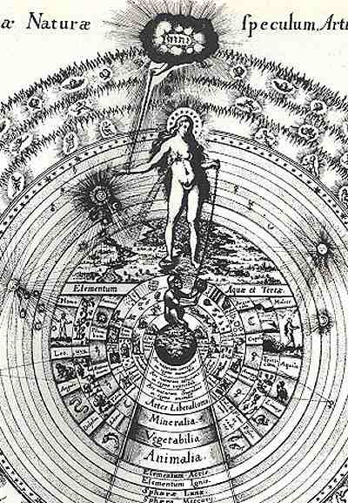
The Great Chain of Being

Slide 3
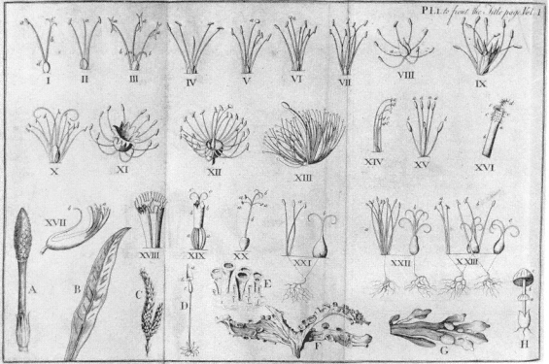
Linnaeus chose a different facet

Slide 4
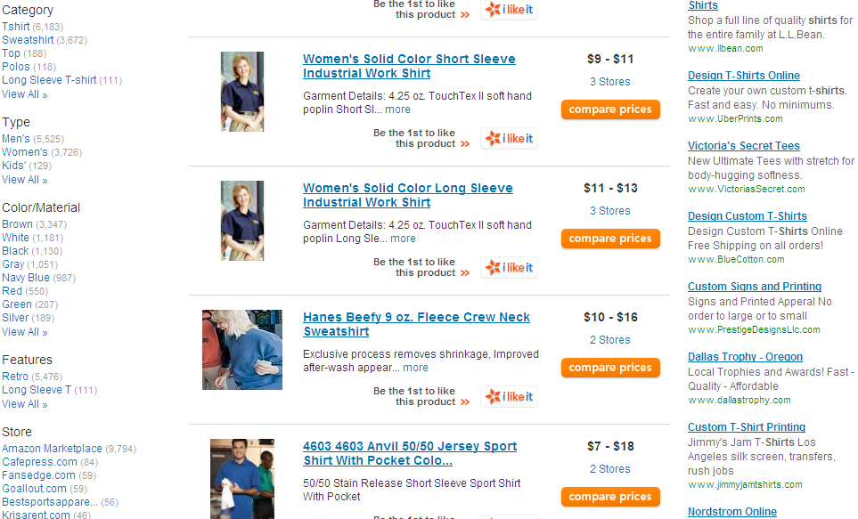

Slide 5
Why do we need facets in Search?
Search result sets are bigger
More metadata associated with each result
Our brains can’t efficiently manage large lists of data

Slide 6
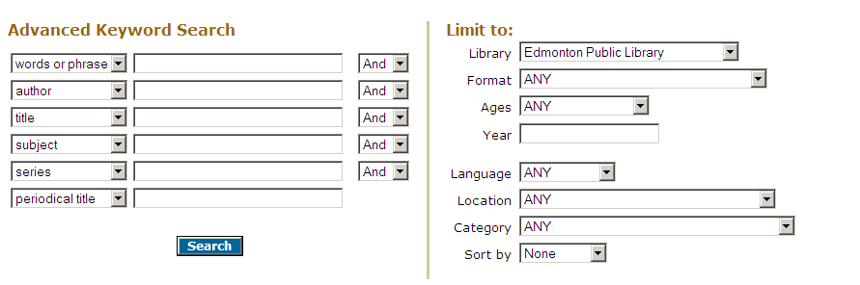
Two search paradigms
Choose your facets beforehand…

Slide 7
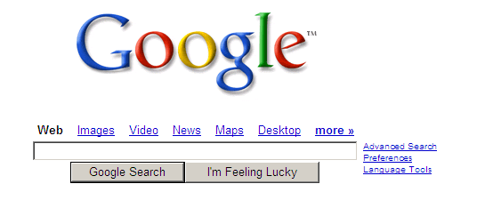
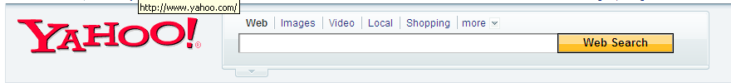
…or not

Slide 8


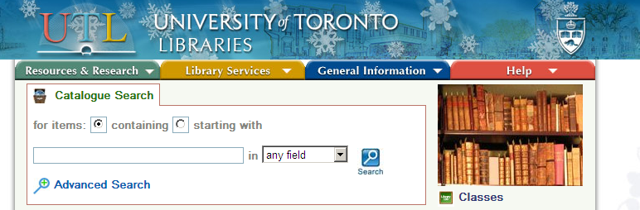
The simple keyword search box has become the tool of choice

Slide 9
Possible Facets
Format
Subject
Language
Author
Place
Era
Publication Date
Genre
Collection

Slide 10
The FAST Model
Several facets are peeled away from LCSH…
Form (Genre)
Chronological
Geographical tag
Personal Names
Corporate Names
…but a Hard Nut Remains:
Topical Subject Headings

Slide 11
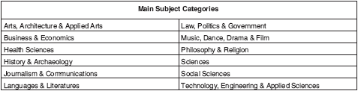
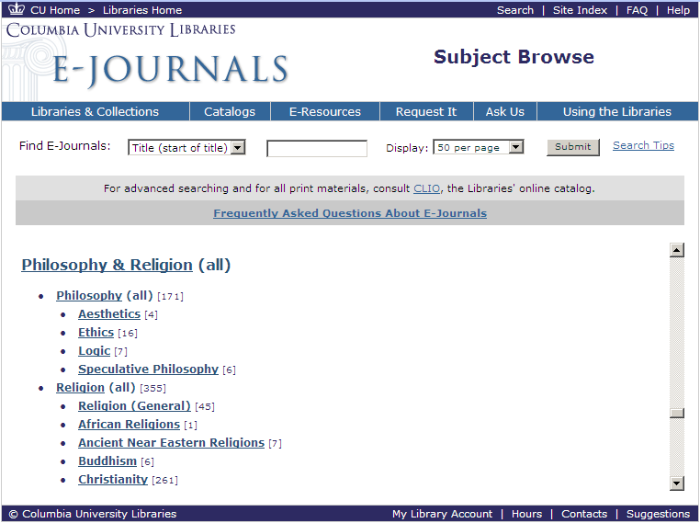
Browsable Hierarchy on a Human Scale - HILCC

Slide 12
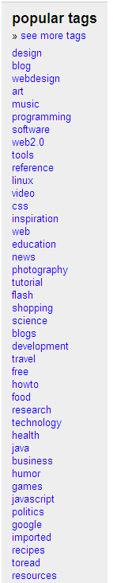
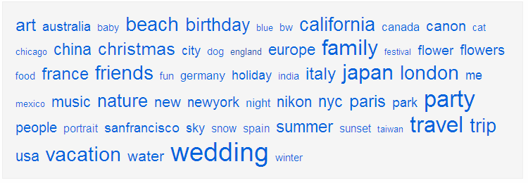
Flat Tag Sets

Slide 13
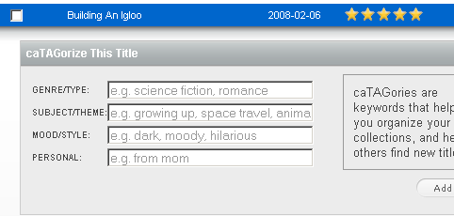
Building Structure in the UI to Make Tags More Focused
Notes:
I guess this is analogous to pre-coordination. More semantically laden.

Slide 14
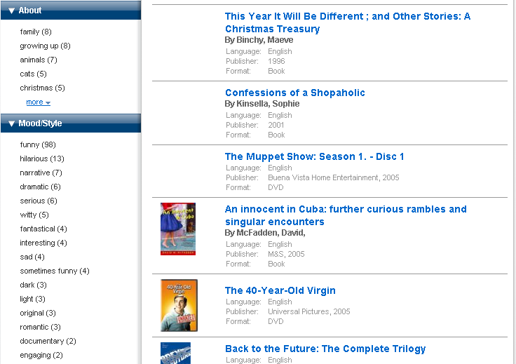
Structured Patron Tags

Slide 15
Clustering Tags 101
Inputs: {User, Tag, Bib}
Start with a similarity measure between tags.
First tag forms initial cluster.
For remaining tags, if similarity between tag and cluster exceeds threshold, add tag to cluster, else create new cluster.
Complications: similarity measures, cluster normalization, multiple cluster membership, etc.

Slide 16
Vector Cosine Similarity
Model each tag as a vector V of weighted features.
Features are bib ids.
Weights are the number of times all users assigned the tag to the feature.
cos(V1, V2) = V1 • V2 / (|V1|*|V2|), yields [0, 1] where 0 is no similarity and 1 is maximal similarity.
Trigonometric interpretation: cosine of angular distance between vectors.
V{1, 3}
θ
θ
V{3, 1}

Slide 17
An Example of a Cluster
(leonardo da vinci, bible stories, intelligent design, christianity, darwinism, opus dei, atheism, family tree of jesus christ, christian ethics, esoteric religion, morality tales, knights templar)

Slide 18
What Clusters Together?
Unifications -- different user vocabularies (a.k.a. synonyms, misspellings, abbreviations).
Abstraction -- different levels of generality (a.k.a. vertical relationships, IS-A, subsumption, hypernym).
  Abstraction navigation.
  Hierarchical roll-up for faceting.
Semantic relationships -- various associations that link terms semantically (a.k.a. horizontal relationships, HAS-A, semantic co-occurrences).
  ‘See also’ navigation.
And yes, spurious associations (a.k.a. noise, crap).

Slide 19
Structuring Clusters (Intrinsic Methods)
Lexical subsumption -- book -> picture book -> children’s picture book.
Operational subsumption -- T1 subsumes T2 if set of bibs tagged by T1 is superset of those of T2 (~80%).
Use association rules to characterize association strength (with support and confidence metrics) between tags and infer relationships.
Social network theory to analyze similarity graph.
  Compute closeness centrality for tags in similarity graph.
  Order tags by maximal centrality.
  Add to taxonomy tree at most similar node or at root if similarity threshold is not met.

Slide 20
Using [Heymann and Garcia-Molina, 2006]
christianity
family tree of jesus christ
opus dei
leonardo da vinci
esoteric religion
knights templar
atheism
intelligent design
darwinism
christian ethics
bible stories
morality tales

Slide 21
Structuring Clusters (Extrinsic Methods)
WordNet ([Stoica, Hearst, Richardson, 2007])
  Synsets to recognize synonyms and polysemy
  IS-A links (hypernyms) to recognize abstraction; can also provide labels for hierarchical facets.
LC Classifications / Subject Headings
Specialized ontologies
  Gazetteers for geospatial tags (e.g., GNS, GNIS, Alexandria Digital Library, Getty thesaurus of geonames).
  Affect taxonomies (Sentiment AI).
Introduces classification task to map into ontologies.
Danger! Ontology structure may introduce noisy structure, causing more problems than benefits.

Slide 22
Widening the Similarity Net
User / community modeling
  Tag profiles for users
  Tag taxonomies for specific user communities.
Bib modeling
  Similar titles based on tag features
  Best of lists for user communities.
Folding in other metadata during clustering
  Pseudotag generation -- automated tag creation from metadata (e.g., LCSH), ontologies, or free text analysis (mining significant terms).

Slide 23
Full General-Purpose Automation?
Techniques are exquisitely sensitive to features that are computationally accessible.
  People use background knowledge and context.
Absolutely useful for solving particular tasks.
Human curation probably a necessary component.
  Bootstrap structure through automated techniques.
  Incentivize curation.
  Manage human time via active learning techniques.

Slide 24
Bibliography
http://del.icio.us/ronbraun/code4libhierarchy

